Slide 1
Film Study

Slide 2
Mise-en-scène
Mise-en-scène is generated by the construction of shots and the ways that they lead to visual coherence, across the edits from shot to shot. It includes all the elements in front of the camera that compose a shot: lighting; use of black and white or color; placement of characters in the scene; design of elements within the shot (part of the process of production design); placement of camera vis-àvis characters in the set; movement of camera and/or actors; composition of the shot as a whole—how it is framed and what is in the frame. Even music may be considered part of mise-en-scène. While not seen, at its best music enhances the visual and narrative construction of the shot.

Slide 3
Describing Shots
When describing camera angles, or creating them yourself, you have to think about three important factors
— The FRAMING or the LENGTH of shot
— The ANGLE of the shot
— If there is any MOVEMENT involved

Slide 4
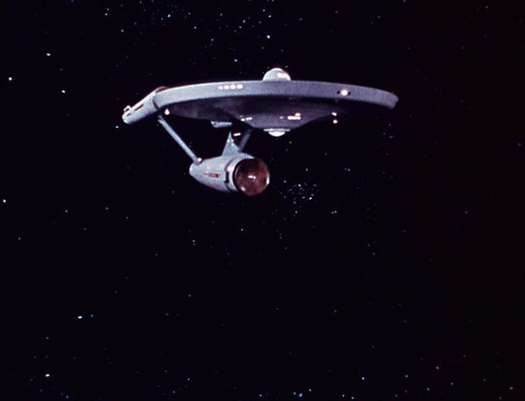
Extreme Long Shot- Establishing shot
Notes:
This can be taken from as much as a quarter of a mile away, and is generally used as a scene-setting, establishing shot. It normally shows an EXTERIOR, eg the outside of a building, or a landscape, and is often used to show scenes of thrilling action eg in a war film or disaster movie. There will be very little detail visible in the shot, it's meant to give a general impression rather than specific information.

Slide 5
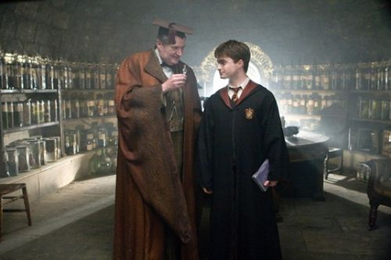
Long Shot
Notes:
This is the most difficult to categorise precisely, but is generally one which shows the image as approximately "life" size i.e. corresponding to the real distance between the audience and the screen in a cinema (the figure of a man would appear as six feet tall). This category includes the FULL SHOT showing the entire human body, with the head near the top of the frame and the feet near the bottom. While the focus is on characters, plenty of background detail still emerges: we can tell Harry and Slughorn are in a classroom, most probably potions because of all the jars.

Slide 6
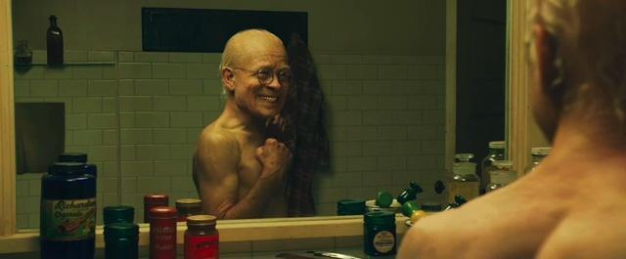
Mid Shot
Notes:
Contains a figure from the knees/waist up and is normally used for dialogue scenes, or to show some detail of action. Variations on this include the TWO SHOT (containing two figures from the waist up) and the THREE SHOT (contains 3 figures...). NB. Any more than three figures and the shot tends to become a long shot. Background detail is minimal, probably because location has been established earlier in the scene - the audience already know where they are and now want to focus on dialogue and character interation. Another variation in this category is the OVER-THE-SHOULDER-SHOT, which positions the camera behind one figure, revealing the other figure, and part of the first figure's back, head and shoulder.

Slide 7
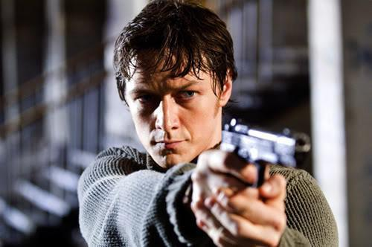
Medium close up

Slide 8
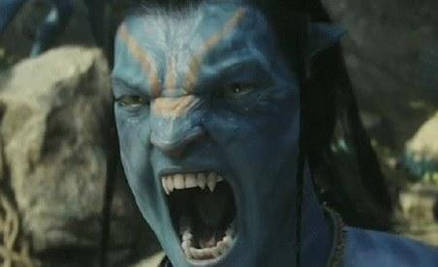
Close up
Notes:
This shows very little background, and concentrates on either a face, or a specific detail of mise en scène. Everything else is just a blur in the background. This shot magnifies the object (think of how big it looks on a cinema screen) and shows the importance of things, be it words written on paper, or the expression on someone's face. The close-up takes us into the mind of a character. In reality, we only let people that we really trust get THAT close to our face - mothers, children and lovers, usually - so a close up of a face is a very intimate shot. A film-maker may use this to make us feel extra comfortable or extremely uncomfortable about a character, and usually uses a zoom lens in order to get the required framing.

Slide 9
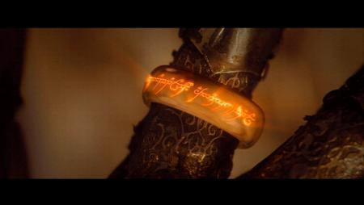
Extreme close up
Notes:
As its name suggests, an extreme version of the close up, generally magnifying beyond what the human eye would experience in reality. An extreme close-up of a face, for instance, would show only the mouth or eyes, with no background detail whatsoever. This is a very artificial shot, and can be used for dramatic effect. The tight focus required means that extra care must be taken when setting up and lighting the shot - the slightest camera shake or error in focal length is very noticeable.

Slide 10
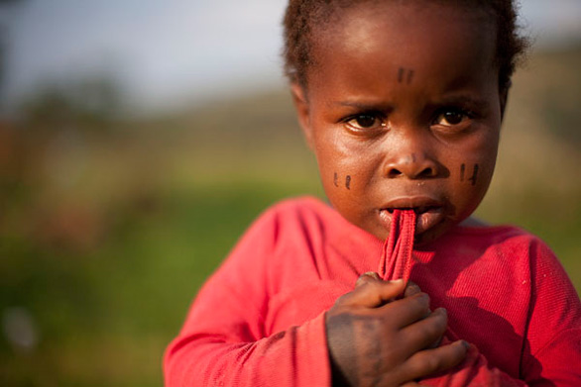
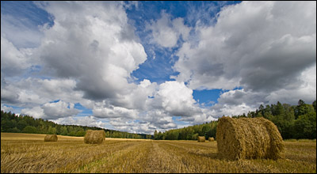
Depth of Field
Shallow DOF
Deep DOF
Notes:
Is the distance between the nearest and farthest objects in a scene that appear acceptably sharp in an image. In some cases, it may be desirable to have the entire image sharp, and a large DOF is appropriate. In other cases, a small DOF may be more effective, emphasizing the subject while de-emphasizing the foreground and background

Slide 11
Camera Angles
The relationship between the camera and the object being photographed (ie the ANGLE) gives emotional information to an audience, and guides their judgment about the character or object in shot. The more extreme the angle (ie the further away it is from eye level), the more symbolic and heavily-loaded the shot.

Slide 12
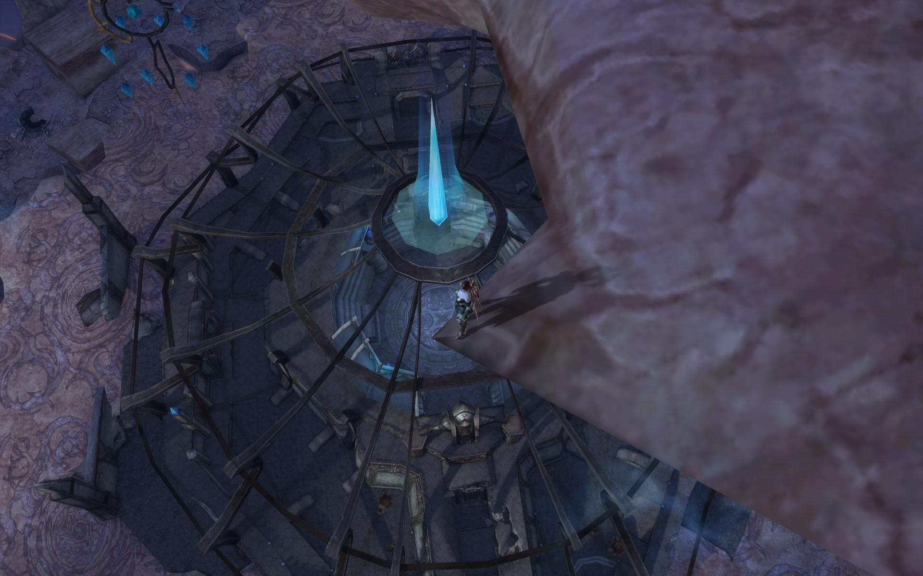
The Bird's-Eye view
Notes:
This shows a scene from directly overhead, a very unnatural and strange angle. Familiar objects viewed from this angle might seem totally unrecognisable at first (umbrellas in a crowd, dancers' legs). This shot does, however, put the audience in a godlike position, looking down on the action. People can be made to look insignificant, ant-like, part of a wider scheme of things. Hitchcock (and his admirers, like Brian de Palma) is fond of this style of shot.

Slide 13
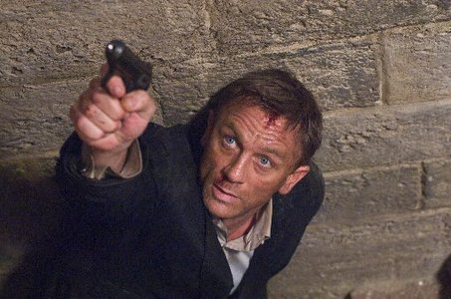
High Angle
Notes:
Not so extreme as a bird's eye view. The camera is elevated above the action using a crane to give a general overview. High angles make the object photographed seem smaller, and less significant (or scary). The object or character often gets swallowed up by their setting - they become part of a wider picture.

Slide 14
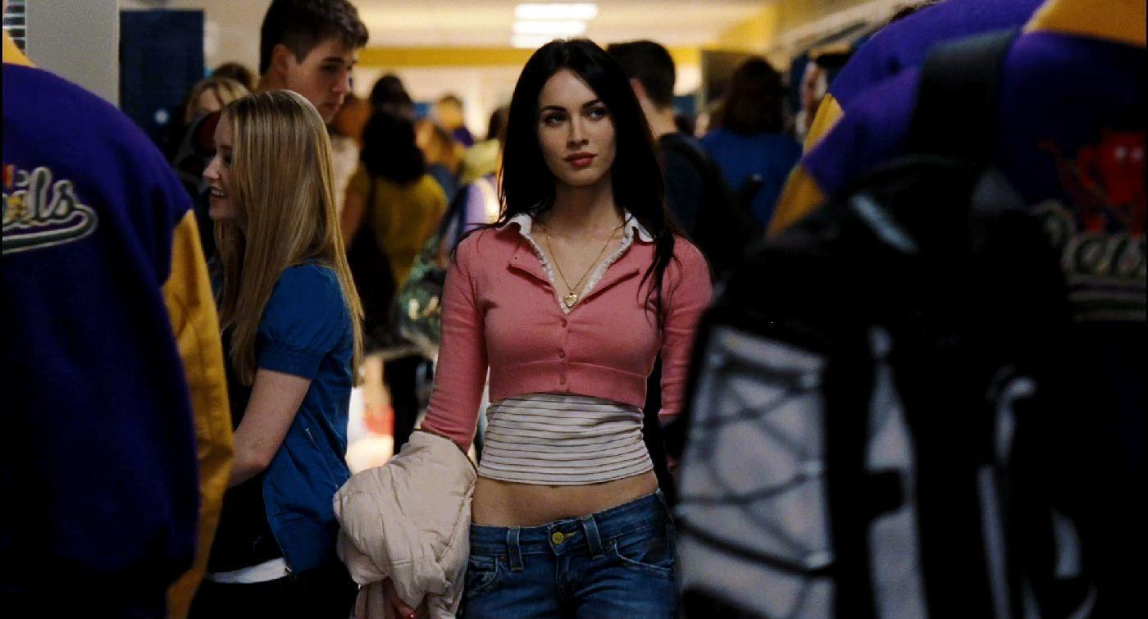
Eye Level
Notes:
A fairly neutral shot; the camera is positioned as though it is a human actually observing a scene, so that eg actors' heads are on a level with the focus. The camera will be placed approximately five to six feet from the ground.

Slide 15
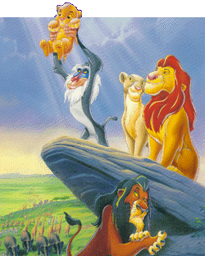
Low Angle
Notes:
These increase height (useful for short actors like Tom Cruise or James McAvoy) and give a sense of speeded motion. Low angles help give a sense of confusion to a viewer, of powerlessness within the action of a scene. The background of a low angle shot will tend to be just sky or ceiling, the lack of detail about the setting adding to the disorientation of the viewer. The added height of the object may make it inspire fear and insecurity in the viewer, who is psychologically dominated by the figure on the screen.

Slide 16
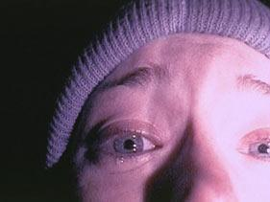
Oblique/Canted Angle
Notes:
Sometimes the camera is tilted (ie is not placed horizontal to floor level), to suggest imbalance, transition and instability (very popular in horror movies). This technique is used to suggest POINT-OF-View shots (ie when the camera becomes the 'eyes' of one particular character,seeing what they see — a hand held camera is often used for this.

Slide 17
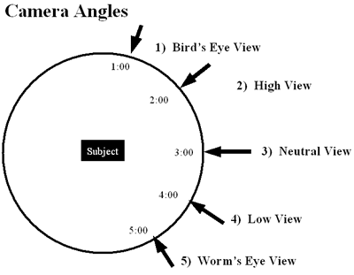

Slide 18
Camera Movement
A director may choose to move action along by telling the story as a series of cuts, going from one shot to another, or they may decide to move the camera with the action. Moving the camera often takes a great deal of time and makes the action seem slower as it takes several seconds for a moving camera shot to be effective when the same information may be placed on screen in a series of fast cuts. Not only must the style of movement be chosen, but the method of actually moving the camera must be selected too. There are seven basic methods:

Slide 19
Pans
Camera moves from side to side.
Notes:
A movement which scans a scene horizontally. The camera is placed on a tripod, which operates as a stationary axis point as the camera is turned, often to follow a moving object which is kept in the middle of the frame.

Slide 20
Tilts
Camera moves up and down
Notes:
A movement which scans a scene vertically, otherwise similar to a pan.

Slide 21
Zoom Lenses
Widest
Wider
Closer
Closest
Notes:
A zoom lens contains a mechanism that changes the magnification of an image. On a still camera, this means that the photographer can get a 'close up' shot while still being some distance from the subject. A video zoom lens can change the position of the audience, either very quickly (a smash zoom) or slowly, without moving the camera an inch, thus saving a lot of time and trouble. The drawbacks to zoom use include the fact that while a dolly shot involves a steady movement similar to the focusing change in the human eye, the zoom lens tends to be jerky (unless used very slowly) and to distort an image, making objects appear closer together than they really are. Zoom lenses are also drastically over-used by many directors (including those holding palmcorders), who try to give the impression of movement and excitement in a scene where it does not exist. Use with caution - and a tripod!

Slide 22
Dolly Shots
Subject
Moves along as a natural movement
Camera
Follows the movement of the subject
Notes:
Sometimes called TRUCKING or TRACKING shots. The camera is placed on a moving vehicle and moves alongside the action, generally following a moving figure or object. Complicated dolly shots will involve a track being laid on set for the camera to follow, hence the name. The camera might be mounted on a car, a plane, or even a shopping trolley (good method for independent film-makers looking to save a few dollars). A dolly shot may be a good way of portraying movement, the journey of a character for instance, or for moving from a long shot to a close-up, gradually focusing the audience on a particular object or character.

Slide 23
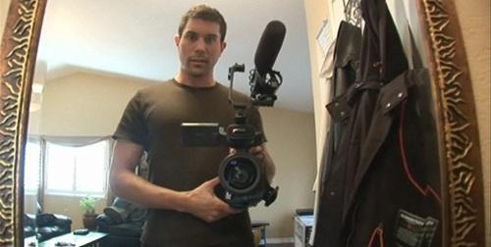
Hand held shots
Notes:
The hand-held movie camera first saw widespread use during World War II, when news reporters took their windup Arriflexes and Eyemos into the heat of battle, producing some of the most arresting footage of the twentieth century. After the war, it took a while for commercially produced movies to catch up, and documentary makers led the way, demanding the production of smaller, lighter cameras that could be moved in and out of a scene with speed, producing a "fly-on-the-wall" effect.This aesthetic took a while to catch on with mainstream Hollywood, as it gives a jerky, ragged effect, totally at odds with the organised smoothness of a dolly shot. The Steadicam (a heavy contraption which is attached a camera to an operator by a harness. The camera is stabilized so it moves independently) was debuted in Marathon Man (1976), bringing a new smoothness to hand held camera movement and has been used to great effect in movies and TV shows ever since. No "walk and talk" sequence would be complete without one. Hand held cameras denote a certain kind of gritty realism, and they can make the audience feel as though they are part of a scene, rather than viewing it from a detached, frozen position.

Slide 24
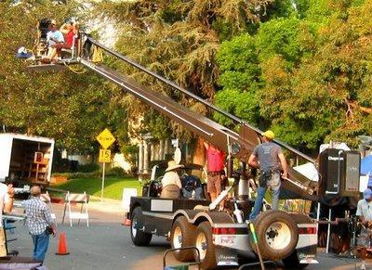
Crane Shots
Notes:
Basically, dolly-shots-in-the-air. A crane (or jib), is a large, heavy piece of equipment, but is a useful way of moving a camera - it can move up, down, left, right, swooping in on action or moving diagonally out of it. The camera operator and camera are counter-balanced by a heavy weight, and trust their safety to a skilled crane/jib operator.

Slide 25
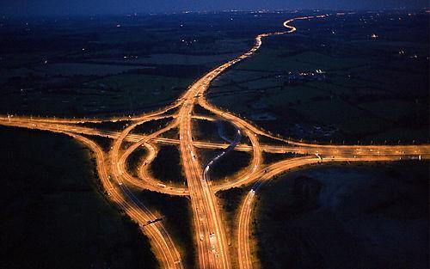
Aerial Shot
Notes:
An exciting variation of a crane shot, usually taken from a helicopter. This is often used at the beginning of a film, in order to establish setting and movement. A helicopter is like a particularly flexible sort of crane - it can go anywhere, keep up with anything, move in and out of a scene, and convey real drama and exhilaration — so long as you don't need to get too close to your actors or use location sound with the shots.

Slide 26
Composition
How the shots are put together.
The layout and structure of a shot can tell us a lot about what the shot represents, how the characters are feeling, their relationships with each other, etc.

Slide 27
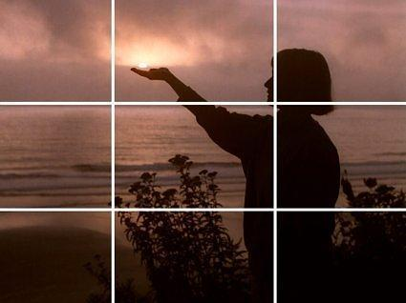
The rule of thirds
Notes:
The Rule of Thirds is a good principle to keep in mind when arranging your subject matter within your photo: Imagine two horizontal and two vertical lines dividing your photo into thirds with four intersecting points—just like a tic-tac-toe board. The Rule suggests that you place your main subject where the lines cross rather than centered in the frame, and situating the horizon on the upper or lower line usually makes a well-composed landscape photo. For portraits, placing the person’s face where lines cross can make a more compelling photo than if the person is centered.

Slide 28
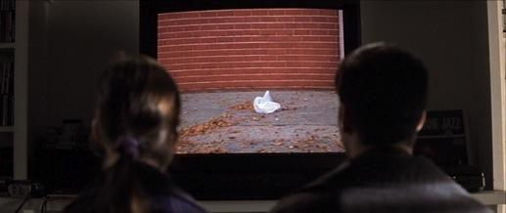

Slide 29
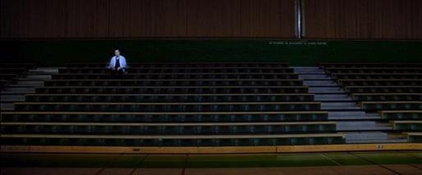
Creating meaning
Notes:
Creates the idea of lots of empty space around Lester and shows his isolation from those around him.

Slide 30
Lighting

Slide 31
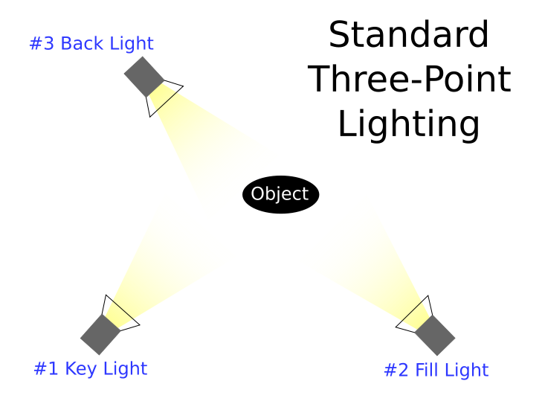
3 Point Lighting
Notes:
In television, film, stage, or photographic lighting, a fill light (often simply fill) may be used to reduce the contrast of a scene and provide some illumination for the areas of the image that are in shadow. A common lighting setup places the fill light on the lens axis, roughly perpendicular to the key light.
The fill light is often softer and, by definition, less intense than the key light. The ratio between light and shadow depends on the desired effect. For example, a fill light that is a small fraction of the power of the key light will produce very high-contrast or low-key lighting, while filling with half or more of the key light power will produce a high key, low-contrast tone.^{[1]}

Slide 32
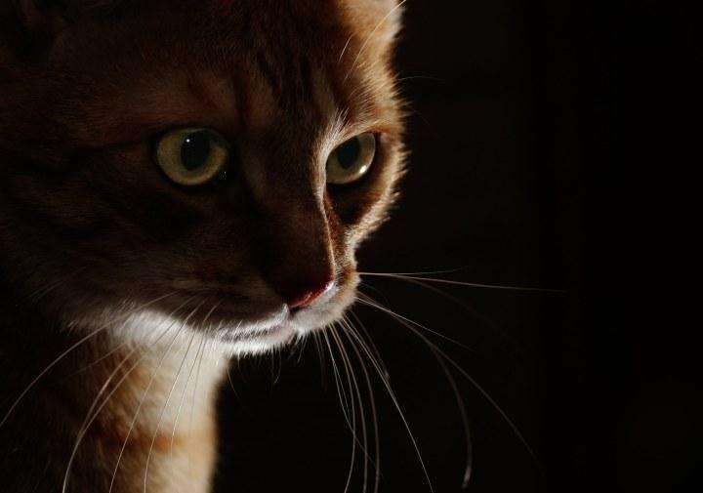
Low Key Lighting
Notes:
Low-key lighting (or ambient lighting) is a style of lighting for photography, film or television. It attempts to create a chiaroscuro effect. In traditional photographic lighting, three-point lighting uses a key light, a fill light, and a back light for even illumination. Low-key lighting requires only one key light, optionally controlled with a fill light or a simple reflector.

Slide 33
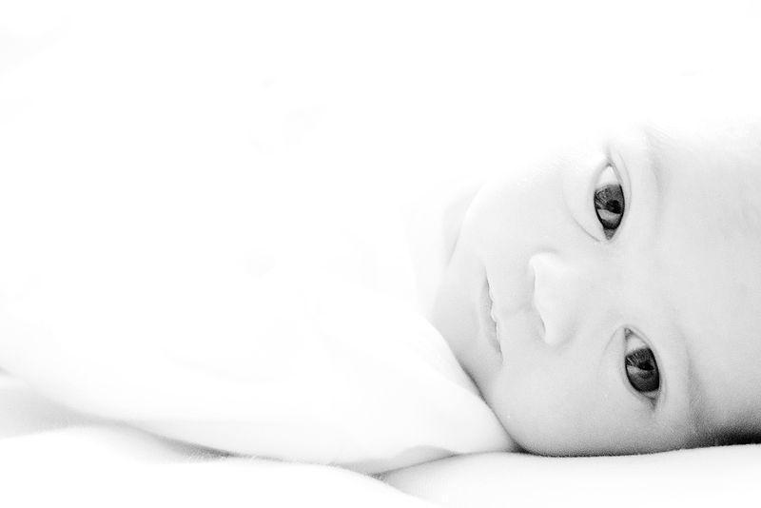
High Key Lighting
Notes:
High-key lighting is a style of lighting for film, television, or photography that aims to reduce the lighting ratio present in the scene. This was originally done partly for technological reasons, since early film and television did not deal well with high contrast ratios, but now is used to suggest an upbeat mood. It is often used in sitcoms and comedies. High-key lighting is usually quite homogeneous and free from dark shadows. The terminology comes from the key light (main light).

Slide 34
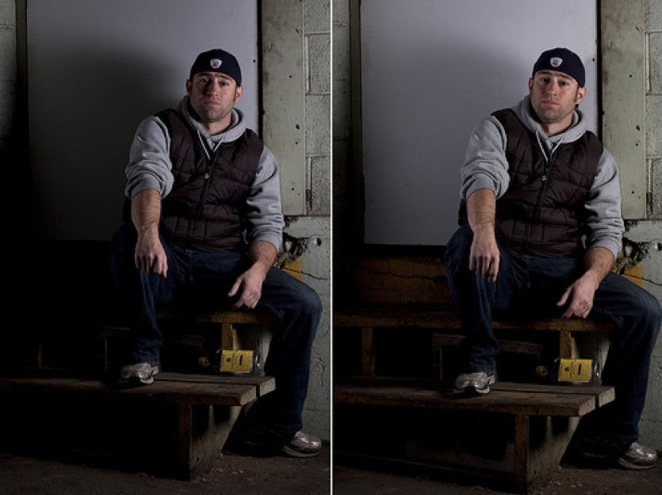
FILL LIGHT

Slide 35
Colour

Slide 36
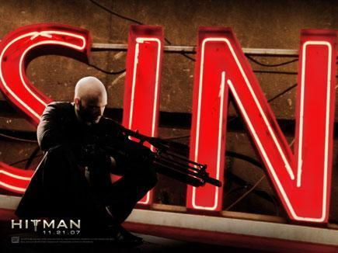

Slide 37
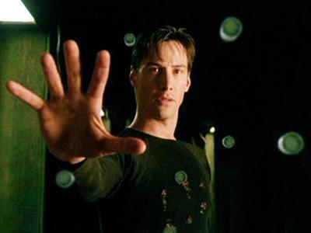

Slide 38
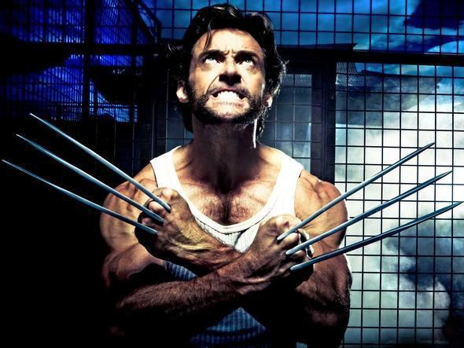

Slide 39
Production design
Sets, props and costumes

Slide 40
Production design is the creation and organization of the physical world surrounding a film story.

Slide 41
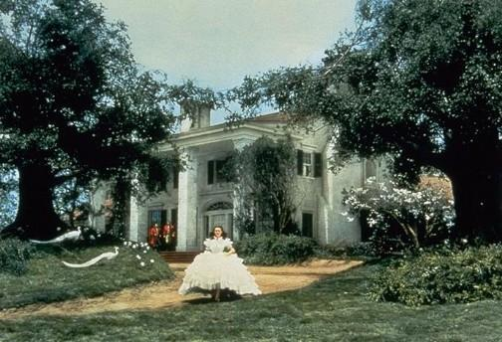
Notes:
Gone with the Wind , for example, has a larger-than-life quality in keeping with the film's inflation of a romantic melodrama to pseudo-epic proportions. The film's impossibly lush and glossy environment is historically accurate, but far too rich (and clean) for a truly realistic depiction of the antebellum South. This somewhat overstuffed environment can no doubt partly be attributed to the pretensions of GWTW 's producer, David O. Selznick.

Slide 42
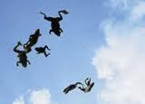

Slide 43
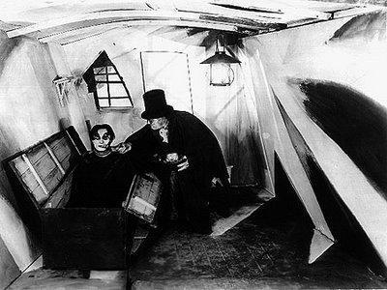

Slide 44
Music

Slide 45
Diegetic
Sound whose source is visible on the screen or whose source is implied to be present by the action of the film:
voices of characters
sounds made by objects in the story
music represented as coming from instruments in the story space ( = source music)
Diegetic sound is any sound presented as originated from source within the film's world Diegetic sound can be either on screen or off screen depending on whatever its source is within the frame or outside the frame.
Another term for diegetic sound is actual sound

Slide 46
Non- diegetic
Sound whose source is neither visible on the screen nor has been implied to be present in the action:
narrator's commentary
sound effects which is added for the dramatic effect
mood music
Non-diegetic sound is represented as coming from a source outside story space. The distinction between diegetic or non-diegetic sound depends on our understanding of the conventions of film viewing and listening. We know of that certain sounds are represented as coming from the story world, while others are represented as coming from outside the space of the story events. A play with diegetic and non-diegetic conventions can be used to create ambiguity (horror), or to surprise the audience (comedy).
Another term for non-diegetic sound is commentary sound.

